Slide 1

Ferns & Petals Sales Analysis Dashboard
Data Analysis using Excel, Power Query, Power Pivot & DAX
Priyanshu Dupare
28-08-2025

Slide 2
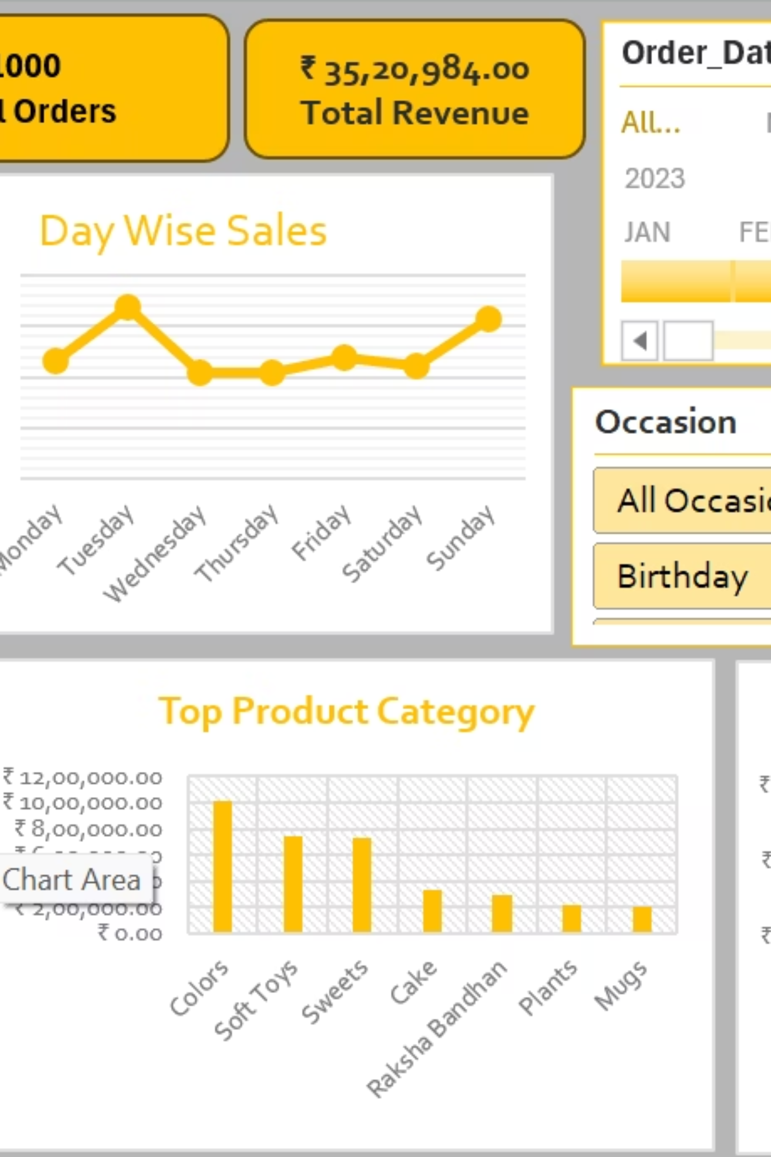
Project Overview
Brief intro about Ferns & Petals and sales dataset.
Purpose: Analyze sales, customer spending, and product performance to derive business insights.
Deliverable: An interactive Excel Dashboard for decision-making.

Slide 3
Objectives
1
Track total revenue & order trends
2
Analyze sales by time (day, month, hour)
3
Identify top-performing products, categories, and locations
4
Measure delivery efficiency
5
Understand customer behavior across occasions

Slide 4
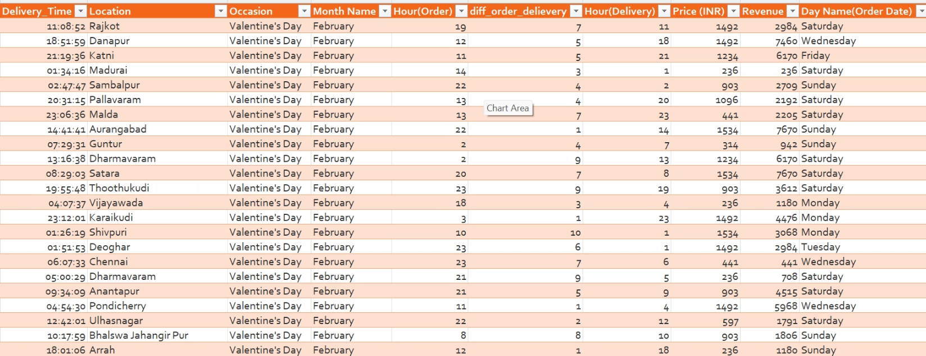
Dataset Description
Tables Used:
Derived Columns:
Customers
Revenue (Price × Quantity)
Orders
Delivery Days
Products
Key Attributes:
Order ID
Order Date
Delivery Date
Quantity
Product Name
Category
Price
Revenue

Slide 5
Tools & Techniques
Excel
Power Query
Power Pivot
Dashboard creation & visualization
Data extraction, cleaning, transformation
Data modeling (Star/Snowflake schema)
DAX
Pivot Tables/Charts
Custom measures (Revenue, Average Days, etc.)
Analysis

Slide 6
Data Cleaning & Transformation
Removed duplicates & null values
Standardized product names & categories
Converted dates to proper formats
Merged tables for revenue calculation
Created calculated fields (Revenue, Delivery Days)

Slide 7
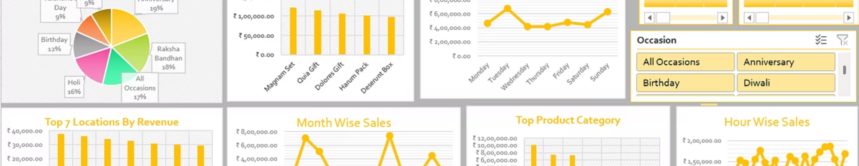
Dashboard Snapshot
Interactive dashboard with slicers for date & occasion filters.

Slide 8




Key Metrics (KPIs)
Total Revenue:
Total Orders:
₹35,20,984
1000
Average Revenue per Order:
Average Delivery Time:
₹3,521
6 Days

Slide 9
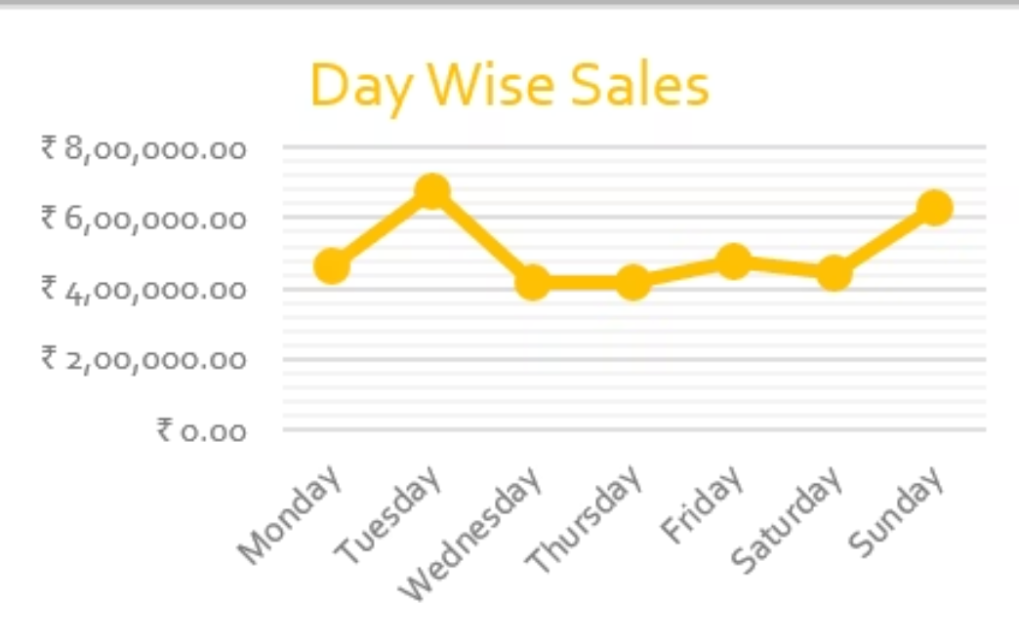
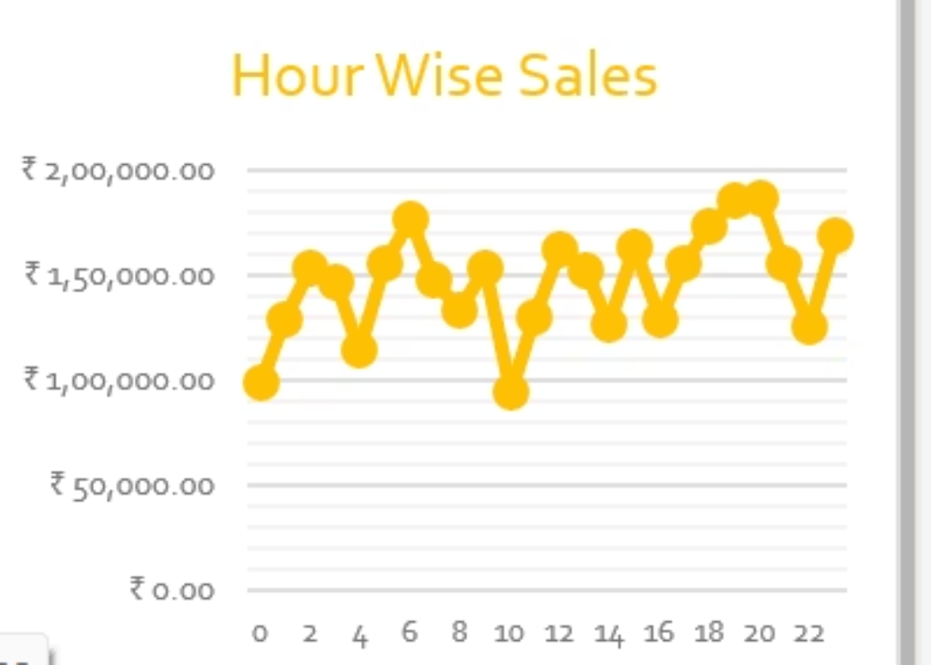
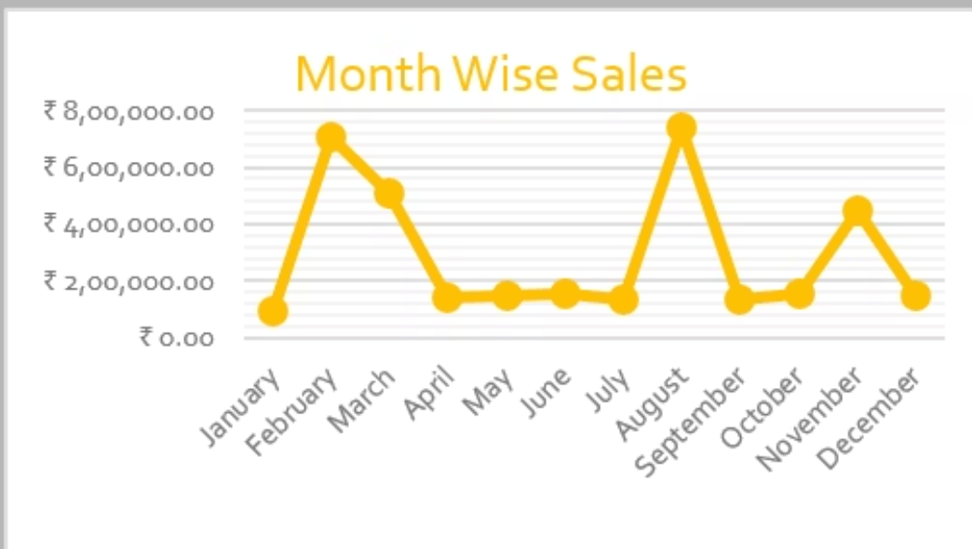
Trend Analysis
Day-wise Trends:
Month-wise Trends:
Hour-wise Trends:
Peaks on Tuesday & Sunday
Highest in February & August (festivals)
Strong demand in evenings

Slide 10
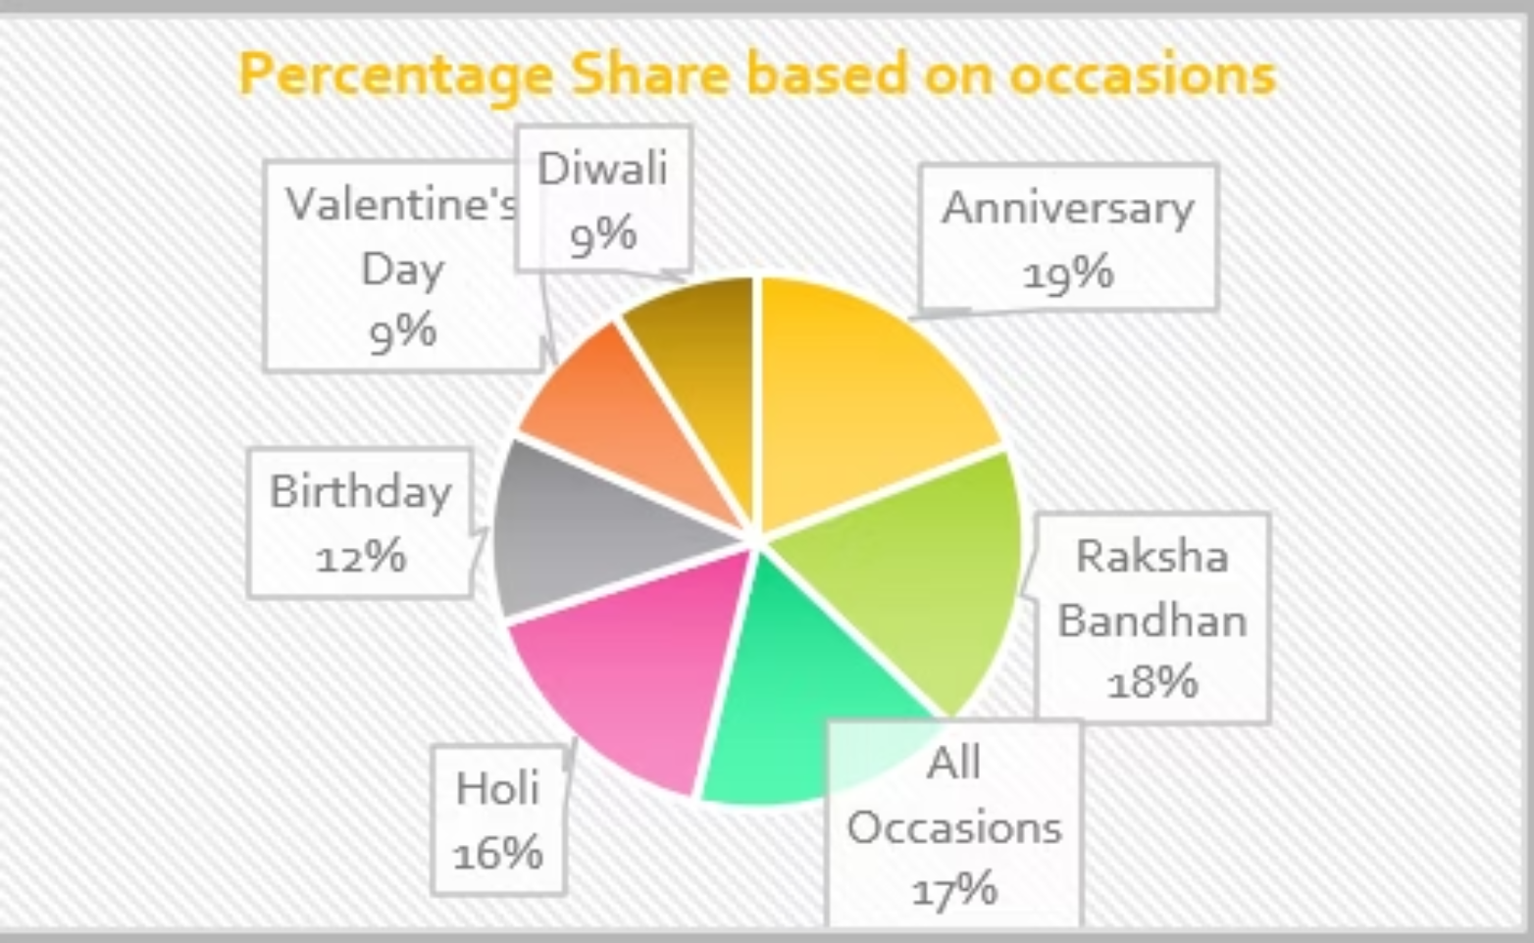
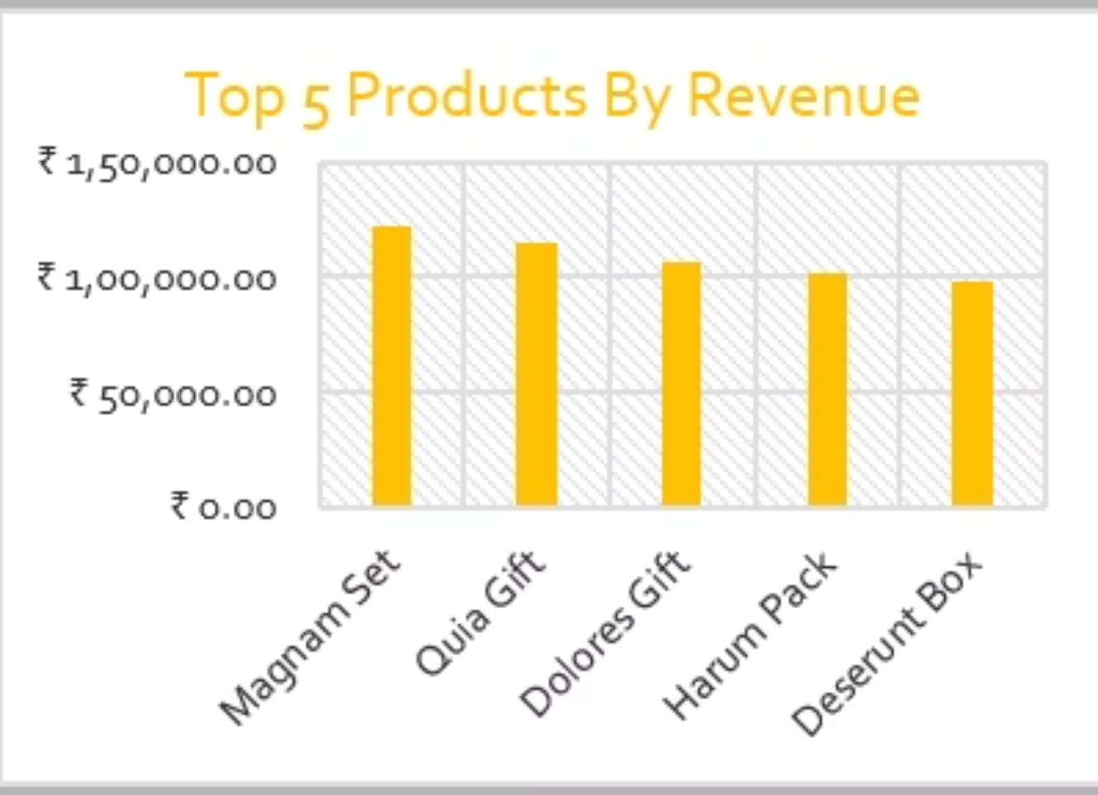
Customer Insights
Occasion Contribution:
Top Products by Revenue:
Anniversary (19%)
Magnam Set
Raksha Bandhan (18%)
Quia Gift
Holi (16%)
Dolores Gift
Birthday (12%)
Top Categories:
Colors
Soft Toys
Sweets

